Slide 1
Attendance Management System
Mentor
Mr. Sumit Singh
Submitted by:
Mani Wadhwa(4166441019)
Pooja Gupta(4166441067)
Pooja Singh(4166441031)

Slide 2
Existing Problems
Students asking teachers for viewing their attendance regularly.
Load on just one person to update the total attendance of all the subjects of every student.

Slide 3
Proposed Solutions
Our project deals with : 1.Maintaining the students' attendance database 2. A tool for teachers to update the data regularly.
Our project is supposed to be an add-on to our own college website. It would help students to check their attendance whenever they want, sitting at their own home.
Teachers will be able to do the tedious work of maintaining attendance with ease and do away with the sheet at the same time. Timely updating and ease of functioning is the major motto of our project.

Slide 4
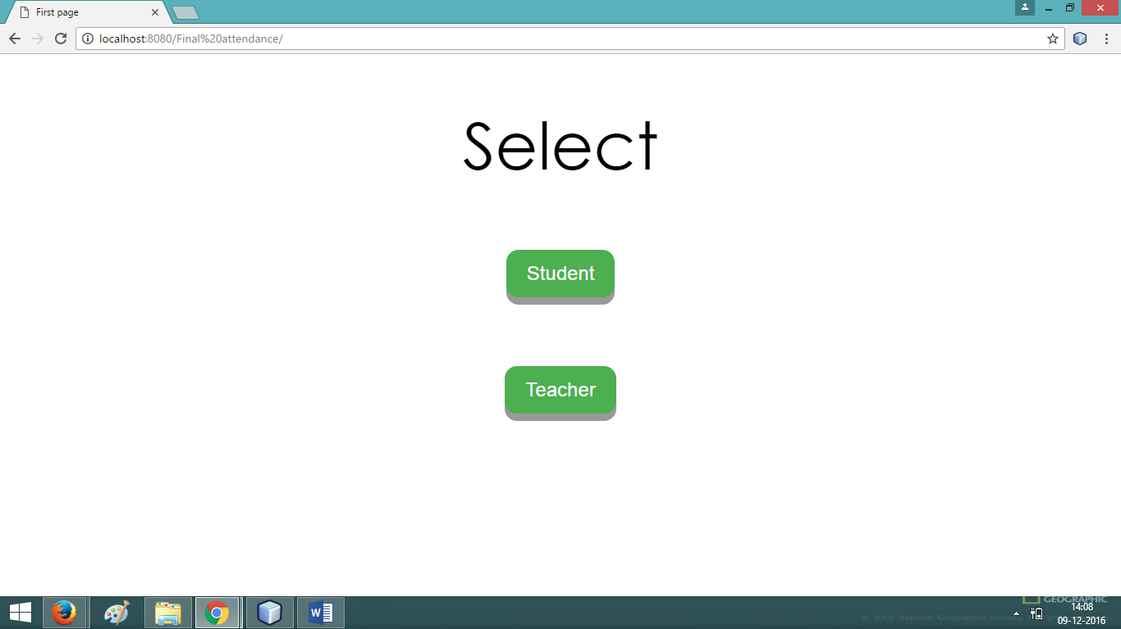
Screens

Slide 5
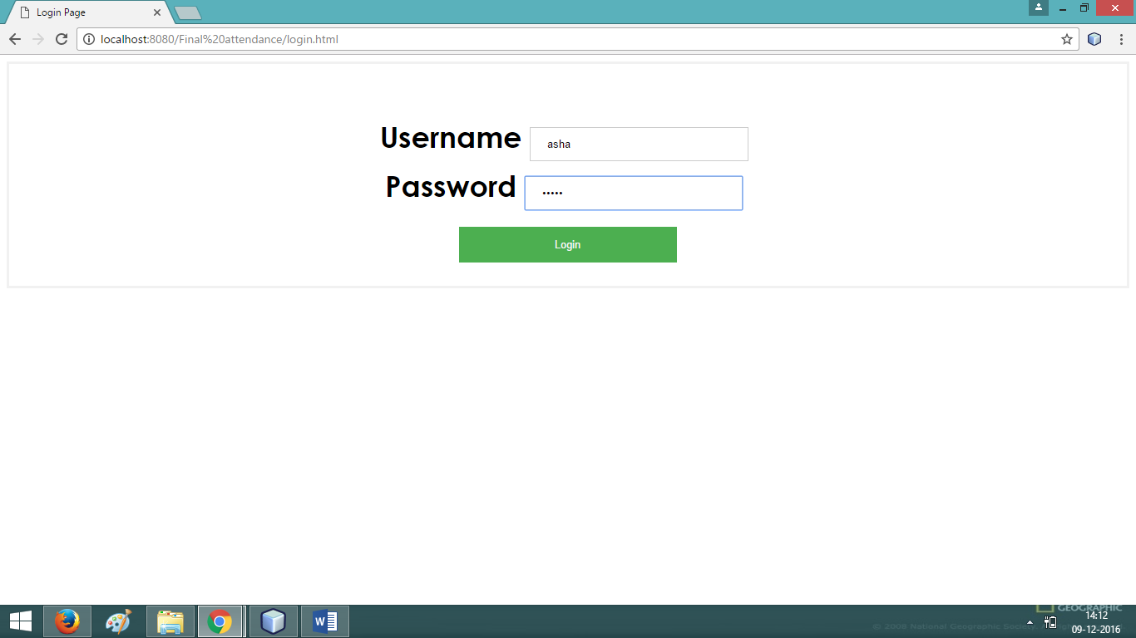
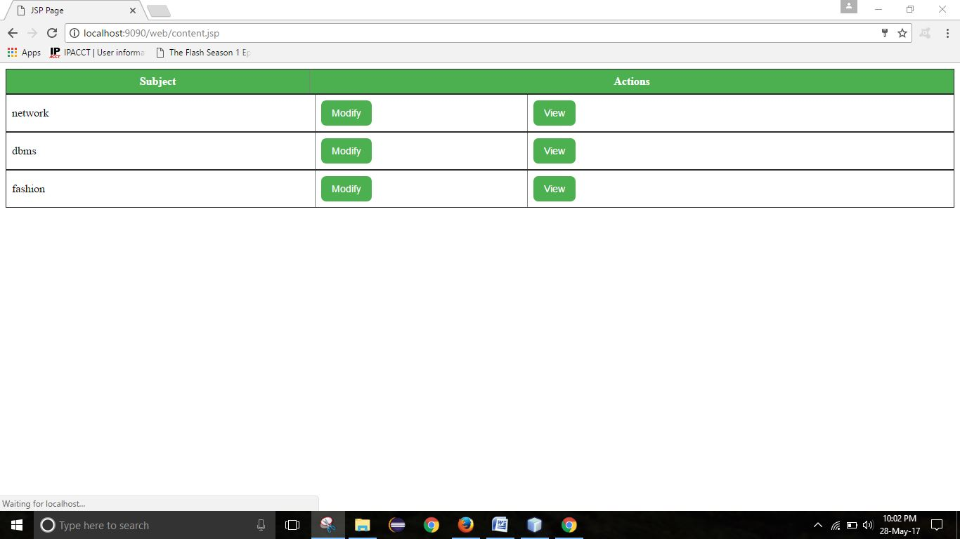

Slide 6
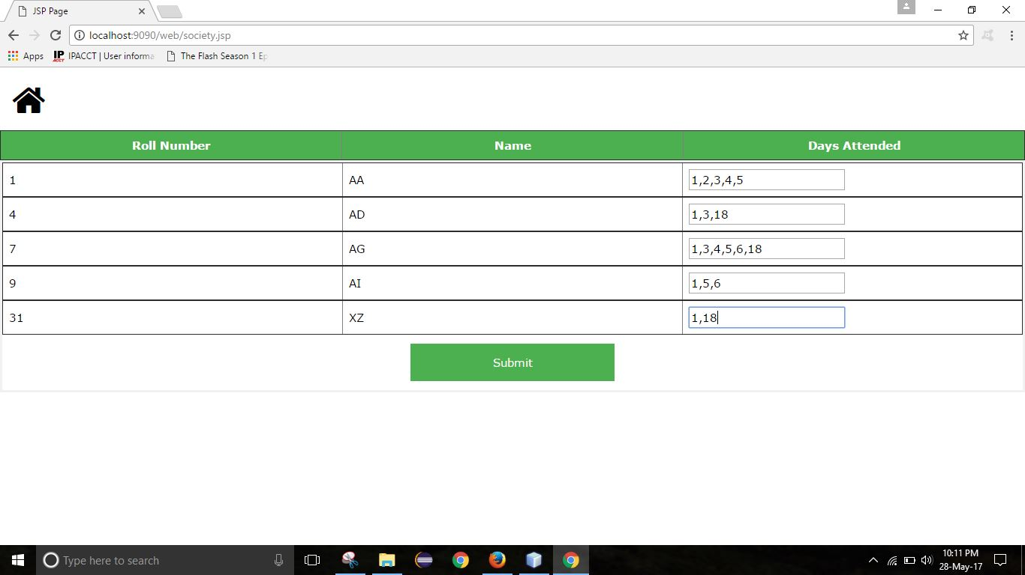

Slide 7
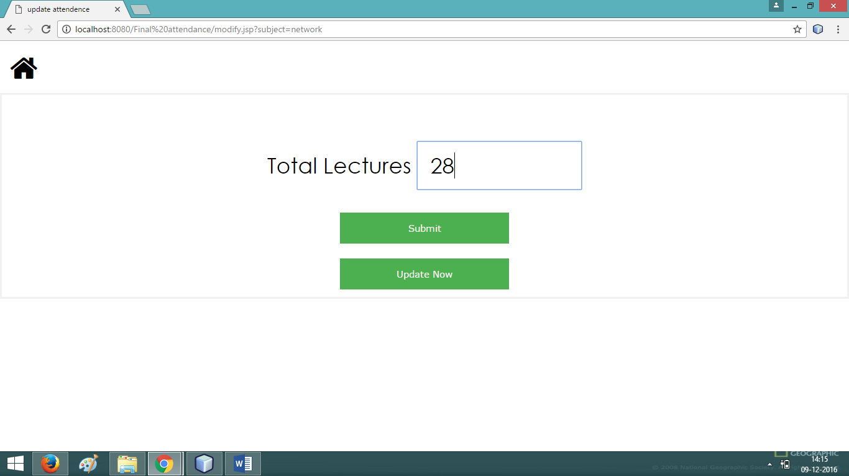

Slide 8
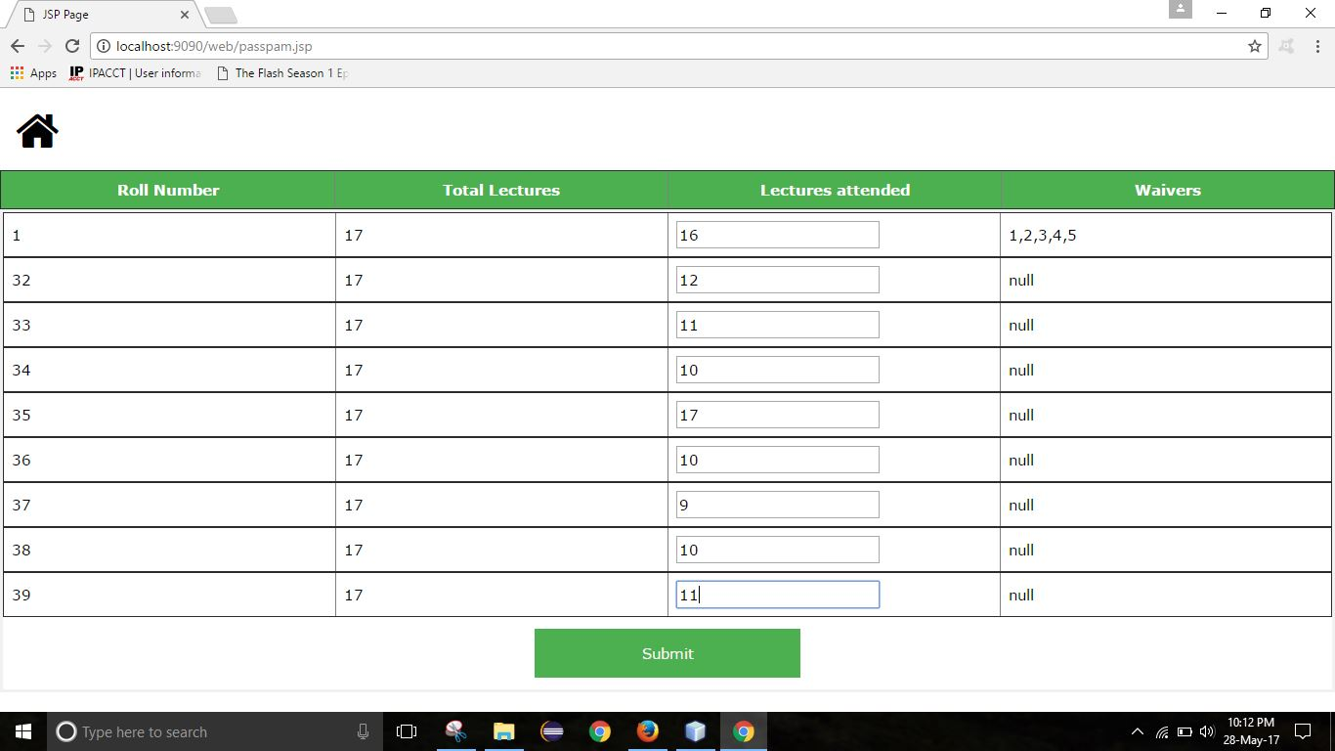

Slide 9
